Slide 1
Business Etiquettes

Slide 2
Etiquette
Etiquette are norms or rules governing socially acceptable behavior.
Some of the common etiquettes are:
Social etiquette
Corporate etiquette
Interview etiquette
Business etiquette

Slide 3
Business etiquette
Business etiquette refers to appropriate behavior in a business setting. By following good etiquette, we present a professional image and interact properly with others at work.
Meeting and Greeting

Slide 4
Principles underpinning all etiquettes
Golden : Treat others as you would like to be treated.
Platinum: Treat others as they would like to be treated.

Slide 5
Types of Business Etiquettes
Business etiquettes
Telephone etiquettes
Dining etiquettes
Office etiquettes
Meeting etiquettes
Dress etiquettes
Netiquettes

Slide 6
Business Etiquettes
Introduction
Language(Lingua franca)
Facial Expression
Do not interrupt the speaker
Do not monopolize the discussion
Motivate silent observers
Inform in advance if you are not attending meeting
Do not take sides on sensitive issues
Set an integrity level
Keep your personal details to the minimum
Don’t be ambiguous but be clear lucid, concise in communication
Be courteous, polite & respectful
Respecting people’s space
Remembering names
Greet people
Use magical words
Use win –win conversation
Praise your employees

Slide 7
Telephone etiquettes
Identify yourself & your company when making a call.
Ask the person if he has a time to talk.
Never be impatient on calls.
Listen carefully.
Make calls during normal working hours .
Incase of missed call return the call within a reasonable period of time.
Never put the person on hold without seeking their permission.
Don’t talk or do other work while talking on phone.
Outline the points before making a call.
Close your conversation with an appropriate salutation.
Let the caller hangup first.

Slide 8
continued
Managing angry callers:
Listen their complaint carefully
Do not interrupt them. Let him finish first.
Empathize with him.
You should be good in your area of work, investigate about his complaint & solve it.
Explain him the whole process of solving the problem
Do not mislead your client.

Slide 9
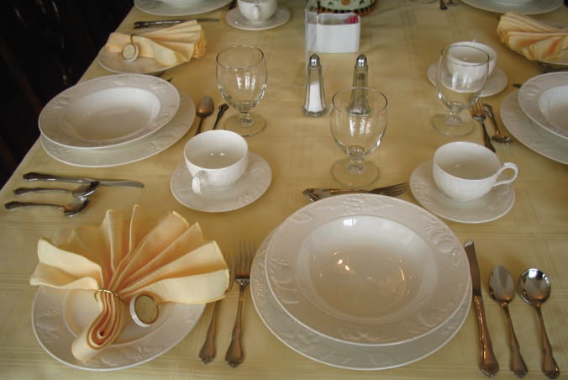

Slide 10
Guidelines for dining
If you host a meal, choose a restaurant appropriate for the person and within your company’s policy, to be sure you’ll get reimbursed. Also ask your guest whether he or she has dietary restrictions that may affect your choice.
Be sure to make reservations. You don’t want to be embarrassed by showing up at a restaurant that cannot accommodate you and your guests.
If a headwaiter seats you and your guest, your guest should precede you to the table. If you’re seating yourselves, take the lead in locating an appropriate table.
Give your guest the preferred seat, facing the window with an attractive view or facing the dining room if you’re seated next to the wall.
If you’re the host, to signal the waiter that you’re ready to order, close your menu and lay it on the table. The host’s order is generally taken last.
Go light on the liquor. You may order wine for the table if others would like to indulge, but keep your own drinking to a minimum.
When the food arrives, guests should not begin eating until the host begins.
Never begin eating until everyone has been served. If yours is the only dish not yet served because of a delay, it’s polite to invite others to begin rather than wait. They may or may not do so.

Slide 11
A business meal is about the conversation—not the food. Stay engaged in the conversation throughout the meal.
Your mother was right: never talk with your mouth full. Take small bites so you can participate in the conversation.
Take your host’s lead for topics. Sometimes, business meals are more social, and discussing too much business is considered inappropriate.
At a formal place setting, the glass on the right side and the bread plate on the left side are yours.
Don’t put your elbows on the table while eating, although you may do so between courses.
If you leave the table during the meal, leave your napkin on your chair. At the end of the meal, place the napkin, unfolded, on the table.
Place the knife across the top edge of the plate, with the cutting edge toward you when it is not being used; don’t keep silverware leveraged on the table and plate like oars. To signal to the server that you have finished, place your knife and fork together on the plate.

Slide 12
Dining etiquettes
Dinning etiquettes refer to the principles of behavior that one should use while having a business meal with colleagues, clients etc. some of the rules which should be followed while dining are:
Be on time.
Wait to sit until the host indicating the seating arrangements.
Stand on the right side of your chair & enter from your left.
Put your napkin in your lap.
Decide on your menu selections quickly.
Never order the most expensive item.
Wait for all people to be served before beginning.
Know which silverware to use with which food.
Salt, pepper passed together.
Generally pass the food to the right.

Slide 13
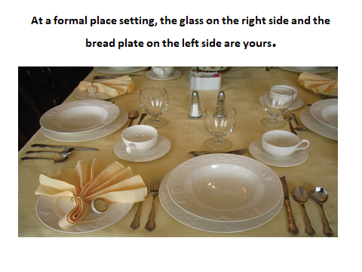

Slide 14
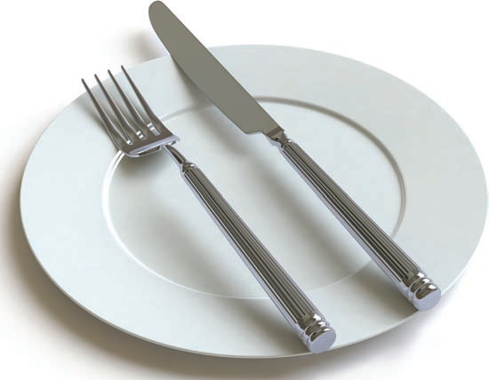
To signal to the server that you are finished, place the knife and fork together on your plate.

Slide 15
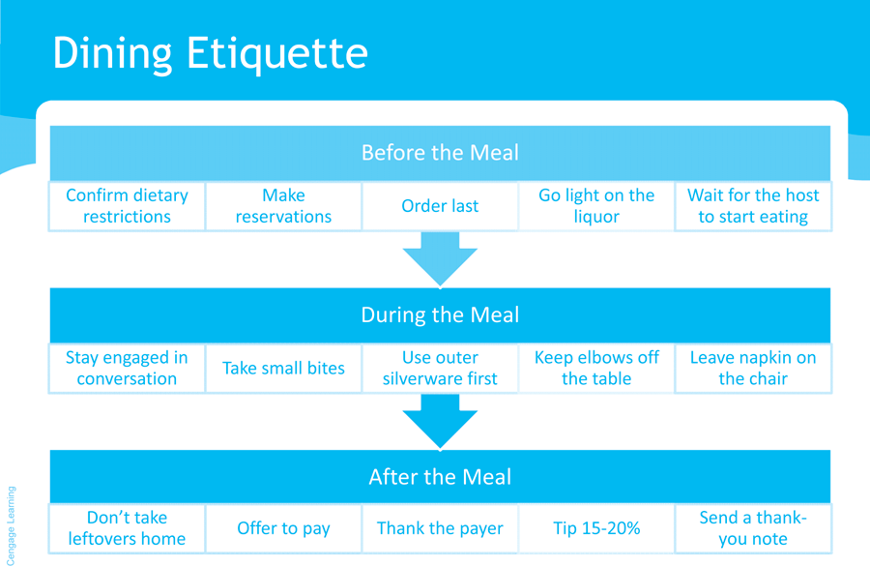

Slide 16
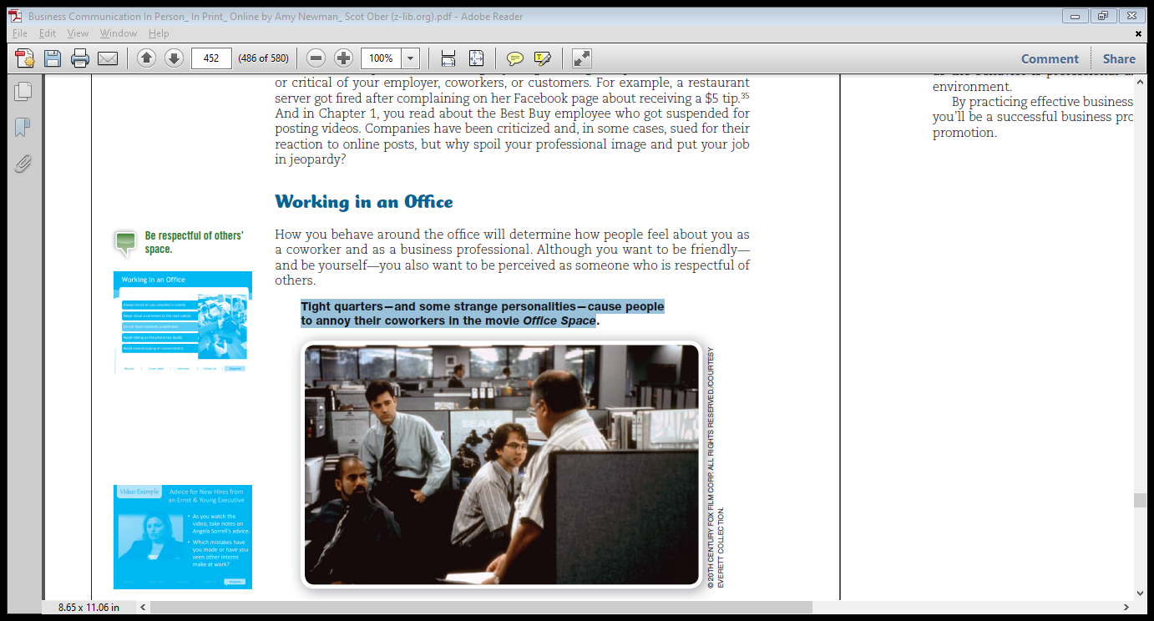

Slide 17
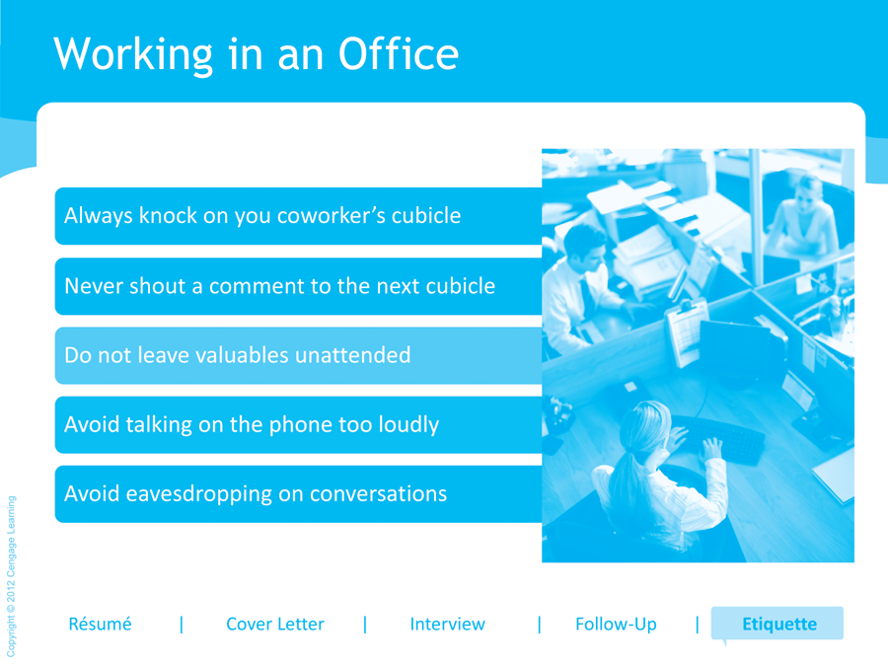

Slide 18
Office etiquettes
Office etiquettes is a code that governs the expectations of social behavior in a work place . Some of the rules which should be utilized by office employees to show proper etiquette are:
Show a healthy respect for colleagues experience & expertise.
Leave your personal life at the front door.
Never go over your manager’s head.
Be self aware. Use common sense.
Be punctual.
Obey your company’s business dress code.
Appear as professional. Well groomed & clean is essential.
Adopt a can-do attitude. Those who accept challenges & display creativity are valuable.
Never read someone’s computer screen or comment on conversation you overhear.
Never enter someone’s cubicle without their permission.
Announce yourself at the doorway or lightly knock on the wall.

Slide 19
Meeting Etiquettes
Meeting Etiquettes refer to the principles of behavior that one should use while having a business meeting.
Handshake is a gesture of acceptance & welcome .Develop a comfortable handshake. It should not be too hard or too soft. Give slight pressure. Web to web , finger to finger
Handshakes are vital in social situations.
Release the hand in three to four seconds.
Eye contact is important . It increases trust, show confidence& good interpersonal skills.it show respect for the person & business situation.
Proper introduction helps to build rapport.
Authority defines whose name is said first in introduction.
Introduce the people in the following order: younger to older, non-official to official, junior executive to senior executive, colleague to customer.
Keep the introduction basic.
Stay around till both the parties start speaking.
Remember names for future reference.
Provide some information about the people you are introducing to clarify your relationship with that person.
Turnoff your cell phones or switch to silent mode. Accept only voice messages & text messages.
Avoid personal questions, favors at first meeting.
Always have your business cards, should be in a good shape & updated.
Be selective in distributing your business cards.

Slide 20
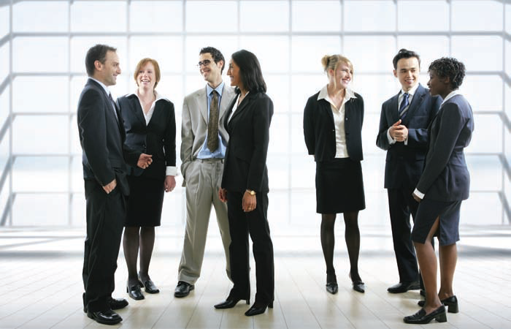
Dressing for Success

Slide 21
Dress etiquette
“The way you dress affects the way you are perceived, and the way you are perceived, is the way you are treated.“
The professional looks
Dress for the part
Simple but classy
Grooming

Slide 22
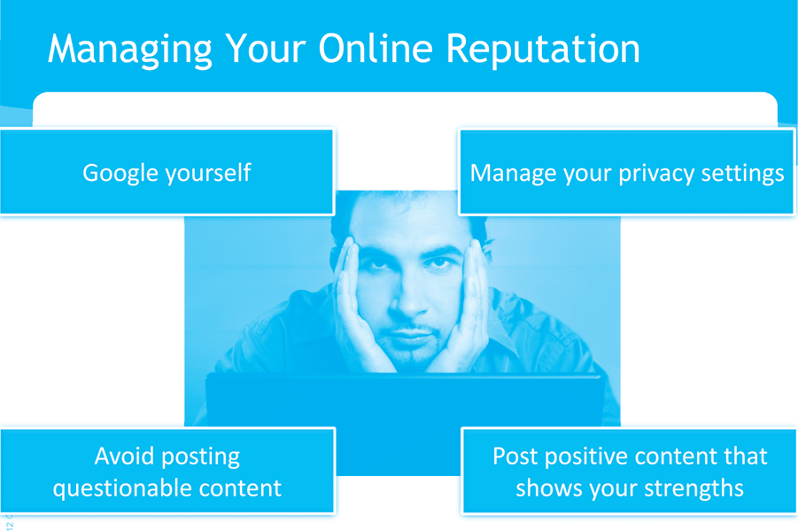

Slide 23
Netiquettes
Netiquettes is the correct or acceptable way of using the internet.
Main Netiquettes that should be fo;;owed in an organization are;
Email etiquette
Chatting etiquette

Slide 24
Grooming
“There are few times in your life when it is not too melodramatic to say that your destiny hangs on the impression you make.”
- Barbara Walters

Slide 25
Personal grooming habits (Females & Males)
Hair : it is your crowning glory.
Keep it at length at which you can maintain it.
For males : should not fall over the ears, eyebrows or even touch the back of the collar.
Facial hair should be neat.
Should be well groomed with a neat appearance at all times
Remember to rinse your mouth after every meal.
People who smoke should rinse their mouth after every smoke.
Light perfume or cologne.
Limited jewelry.
Cleaned & trimmed finger nails.
Concealed tattoos
Polished shoes
stocking

Slide 26
Uniform
Your uniform talks a lot about your organization.
A neat, clean & well ironed uniform is acceptable & appreciated by one and all at all times.
Your id tags are also an important part of your uniform.

Slide 27
Makeup & jewelry( Women)
Make up should be natural looking.
Nail paint & lipstick color should not be too trendy or bright.
Mild fragrance.
Unnatural hair colors must be avoided.
Jewelry when tastefully worn , is always as asset to your outfit.
Be cautious of wearing dangling earrings unless they are small.

